Slide 1
BINARY SEARCH ALGORITHM

Slide 2
Searching Algorithms
Linear Search
Binary Search
Linear Search
Linear search takes an array and a key element to search. Iterates through each element of the array and compares it with the key element. If a match is found, it returns the index of the element. If the key element is found, it returns its index; otherwise, it returns -1.
Time complexity: O(n).
Space complexity: O(1) for iterative and O(n) for recursive.

Slide 3
Example
Code
def linear_search(arr, target):
for index in range(len(arr)):
if arr[index] == target:
return index
return -1
arr = [10, 23, 45, 70, 11, 15]
key = 70
result = linear_search(arr, key)
if result != -1:
print("Element found at index : ",result)
else:
print("Element not found in the array")
Output
Element found at index: 3

Slide 4
What is Binary Search Algorithm?
Binary search is a search algorithm used to find the position of a target value within a sorted array. It works by repeatedly dividing the search interval in half until the target value is found or the interval is empty. The search interval is halved by comparing the target element with the middle value of the search space. The idea of binary search is to use the information that the array is sorted and reduce the time complexity to O(log N).

Slide 5
Below is the step-by-step algorithm for Binary Search:
Divide the search space into two halves by finding the middle index “mid”. Compare the middle element of the search space with the key.
If the key is found at middle element, the process is terminated.
If the key is not found at middle element, choose which half will be used as the next search space.
If the key is smaller than the middle element, then the left side is used for next search.
If the key is larger than the middle element, then the right side is used for next search.
This process is continued until the key is found or the total search space is exhausted.

Slide 6
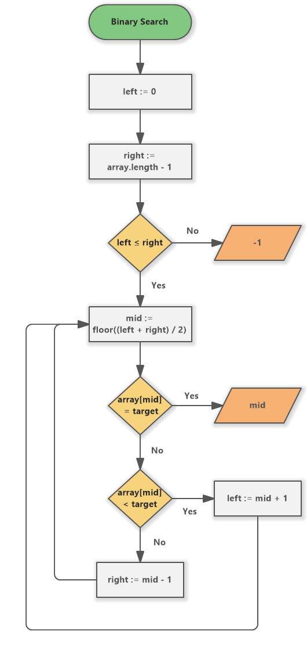
Flow Chart for Binary Search Algorithm

Slide 7
Pseudocode for Binary Search
function binarySearch(arr, n, key) is
low := 0
high := n − 1
while low ≤ high do
mid := floor((low + high) / 2)
if arr[mid] < key then
low := mid + 1
else if arr[mid] > key then
high := mid − 1
else:
return mid
return -1

Slide 8
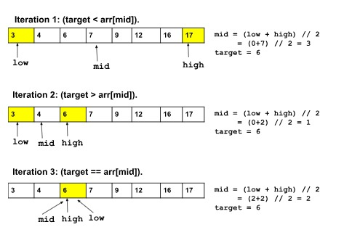
Example
Let’s say the given array is = [3, 4, 6, 7, 9, 12, 16, 17] and target = 6

Slide 9
Implementing the Binary Search Algorithm
There are two common ways to implement the Binary search algorithm:
The Iterative method
The Recursive method

Slide 10
The Iterative Approach
Code :
def binarySearch(arr, low, high, x):
while low <= high:
mid = low + (high - low) // 2
if arr[mid] == x:
return mid
elif arr[mid] < x:
low = mid + 1
else:
high = mid – 1
return -1
arr = [2, 3, 4, 10, 40]
x = 10
result = binarySearch(arr, 0, len(arr)-1, x)
if result != -1:
print("Element is present at index", result)
else:
print("Element is not present in array")
Output :
Element is present at index 3

Slide 11
The Recursive Approach
Code :
def binarySearch(arr, low, high, x):
if high >= low:
mid = low + (high - low) // 2
if arr[mid] == x:
return mid
elif arr[mid] > x:
return binarySearch(arr, low, mid-1, x)
else:
return binarySearch(arr, mid + 1, high, x)
else:
return -1
arr = [2, 3, 4, 10, 40]
x = 10
result = binarySearch(arr, 0, len(arr)-1, x)
if result != -1:
print("Element is present at index", result)
else:
print("Element is not present in array")
Output :
Element is present at index 3

Slide 12
Complexity of Binary Search
Time Complexity:
Best case complexity: If the searched element is found on the first comparison (i.e., it's the middle element), we have the best case scenario. In this case, the time complexity is O(1).
Average Case Complexity: The average case time complexity for Binary Search is O(logn).
Worst-case complexity: The worst-case scenario occurs when we need to keep reducing the search space until it has only a single element. In this case, the time complexity is O(logn).

Slide 13
Space Complexity:
The space complexity in the binary search algorithm is O(1).
Applications:
Looking up a word in a dictionary.
Finding a specific address on a street.
Finding a specific value in a sorted database.
Finding the First or Last Occurrence of an Element.
Finding the Square Root of a Number.

Slide 14
Advantages of Binary Search:
Binary search is faster than linear search, especially for large arrays.
More efficient than other searching algorithms with a similar time complexity, such as interpolation search or exponential search.
Binary search is well-suited for searching large datasets that are stored in external memory, such as on a hard drive or in the cloud.
Disadvantages of Binary Search:
The array should be sorted.
Binary search requires that the elements of the array be comparable, meaning that they must be able to be ordered.

Slide 15
Thank You

